Slide 1
Course Agenda
What is unit testing and why?
What is JUnit?
Junit 5 introduction
Junit 5 Architecture
Unit testing examples
Mockito
Rest API Unit testing

Slide 2
What is unit testing and why?
Unit testing is a type of software testing where individual units or components of software are tested.
Unit tests isolate a section of code and verify its correctness.
A unit may be an individual function, method, procedure, module, or object.

Slide 3
What is Junit ?
Junit is a free and open-source Unit Testing framework for Java applications.
It became one of the most popular testing frameworks in the Java community.
It is a lightweight testing framework that allows Java developers to write unit test cases in Java language.
The current version of Junit is 5.

Slide 4
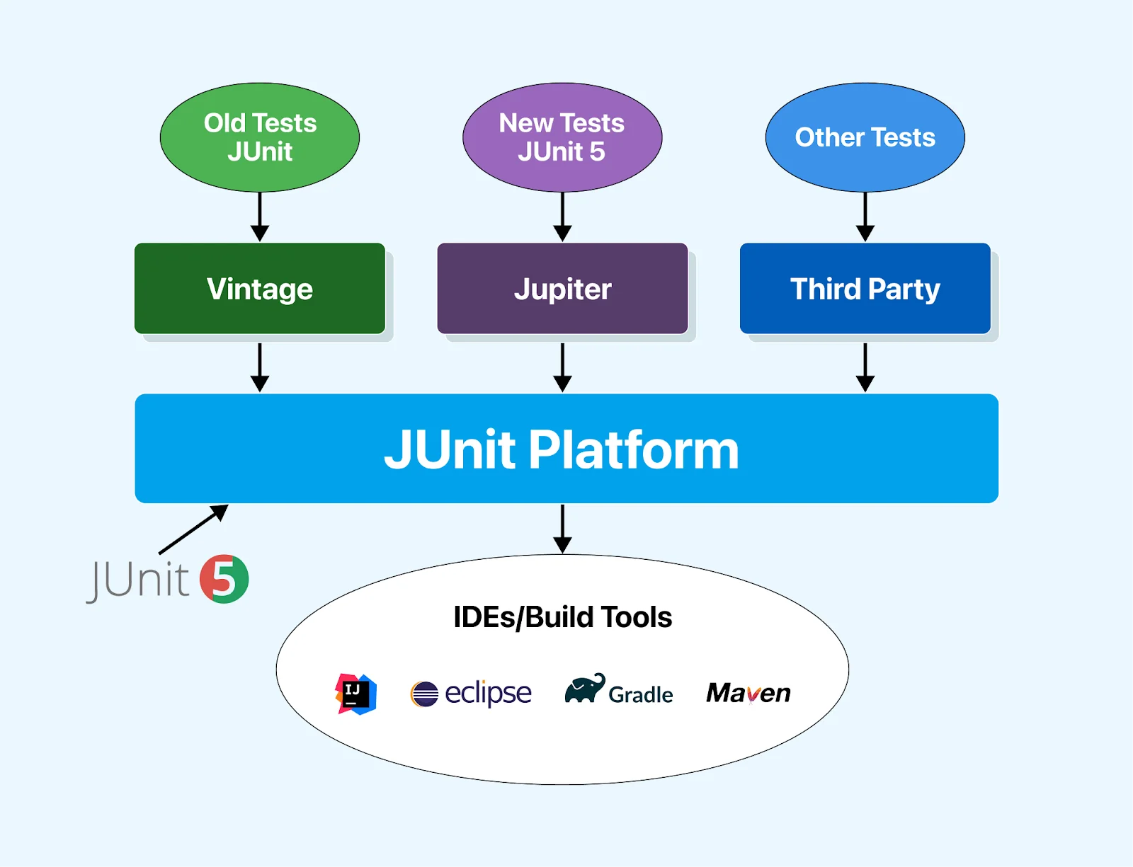
Junit 5 Architecture

Slide 5
Junit Platform: is providing the environment to run our test classes from multiple sources (IDE’s).
Junit Jupiter: is providing new annotations, and new assertions to perform better unit testing.
Junit vintage: is used to provide backward compatibility ( JUnit3 and JUnit4 ).

Slide 6
@Test: is used to represent one method as a unit test method.
@BeforeEach: Before executing each test case method, some logic is executed.
@AfterEach: After executing each test case method, some logic is executed.
@BeforeAll: Before executing all test case methods, some logic is executed.
@AfterAll: After executing all test case methods, some logic is executed.
@ParameterizedTest: is used to pass multiple parameters and test the unit test, so we don’t want to write multiple test methods.
@ValueSource
@CSVSource
@CSVFileSource
@MethodSource
@RepeatedTest: If we want to execute one test method multiple times.
@Disable: If we don’t want to execute the test method.

Slide 7
JUnit 5 assertions:
JUnit 5 assertions help us in validating the expected output with the actual output of a test case.
In short, assertions are nothing but static methods that we call in our tests to verify expected behavior.
All JUnit Jupiter assertions are present in the org.junit.jupiter.Assertions class.

Slide 8
Junit Assertion Methods:
assertEquals and assertNotEquals
assertTrue and assertFalse
assertNull and assertNotNull
assertSame and assertNotSame
assertThrows

Slide 9
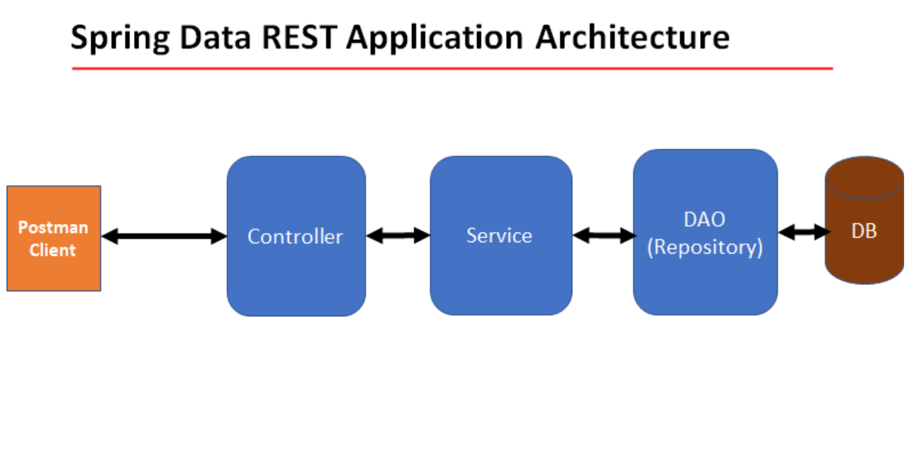

Slide 10
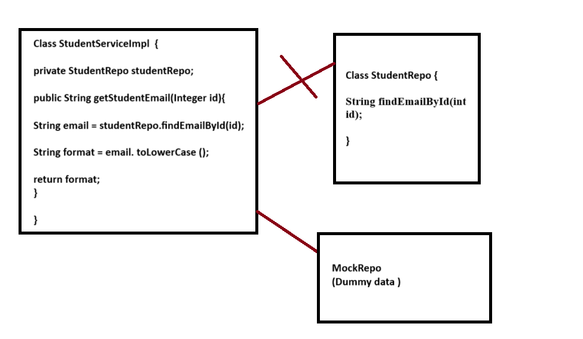

Slide 11
What is Mocking?
Mocking is a process used in unit testing when the unit being tested has external dependencies.
Why we are using mocking?
The purpose of mocking is to achieve an isolated manner of testing and focus on the code being tested and not on the behavior or state of external dependencies.
When we use mocking?
Whenever a component has some external dependencies we will go for mocking.

Slide 12
Mock Frameworks
There are multiple mocking frameworks are available :
Easy Mock :
Proxy-based mock framework (focuses on interfaces and classes but does not support final methods, final classes, or private methods).
PowerMock:
Bytecode manipulation-based mock framework (allows mocking of static methods, final classes, private methods, and constructors).
Mockito:
Proxy-based mock framework (supports mocking of interfaces and classes, but with limitations around final classes, static methods, and private methods without additional setup).

Slide 13
Thank You All…..

